Slide 1
SEARCHING
(Data Structure)
Ms. P. V. Kharbuli, Computer Sc.

Slide 2
Searching
Definition:
Looking for a particular key value in a given list. If we find the key value, then search is successful otherwise it is unsuccessful.
Types of searching:
  Linear/Sequential Search
  Binary Search

Slide 3
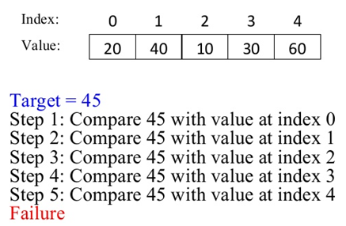
Sequential Search

Slide 4
Sequential Search
int seqSearch(int a[],int n, int x)
{
int i;
for(i=0; i<n; i++)
{
if(a[i]==x)
return 1;
}
return 0;
}
//returns 1 if element x if found else returns 0

Slide 5
Binary Search
A binary search works on an ordered list, and first compares the key with the element in the middle of the array. (In the case of an even number of elements in our list, we will use the element that ends the first half of the list as our "middle element").
  If the key is less than the middle element, we only need to search the first half of the array, so we continue searching on this smaller list.
  If the key is greater than the middle element, we only need to search the second half of the array, so we continue searching on this smaller list.
  If the key equals the middle element, we have a match -- end the search

Slide 6
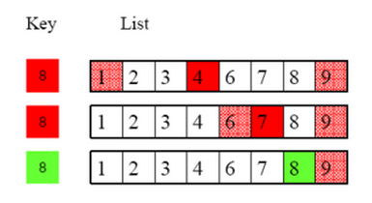
Binary Search
int binarySearch(int a[],int n, int x){
int low,up,mid;
low=0;
up=n-1;
while(low<up)
{
mid=(low+up)/2;
if(x==a[mid])
return 1;
else if(x<a[mid])
up=mid-1;
else
low=mid+1;
}
return 0;
}

Slide 7
Binary Search
Complexity:
o(log2n)
Advantage:
  Faster and more efficient than linear search
Dis-advantage:
  Array has to be sorted

Slide 8
Hashing
Definition
  Sequential/binary search are based on comparing a given key with existing key values in a list.
  Hashing provides a conceptually different mechanism to search a table for a given key value.
  In hashing, the record for a key value “k”, is directly referred by calculating the address from the key value

Slide 9
Hash Functions
Consider there are n elements to be stored in a hash table of size M where (M>=n).
An element with key value “k”will be put in position “j” if
h(k)=j;
Here, h is called a hash function.
It is required to find a hash function f(key) which transforms keys into addresses in the range 0 to (M-1)
An ideal hash function should distribute the keys uniformly over the range 0 to (M-1)
Number of collisions is low for a good hash function

Slide 10
Methods for Hashing
They are
  The Division Method
  The Mid Square Method
  Folding

Slide 11
The Division Method
Definition
  Here, the key “k” is divided by M and the remainder is taken as the address for the key “k”.
  Thus, the hash function is given by: h(k)=k mod M
Advantage:
  produces addresses exactly in the range 0 to M-1
Choice for M: (either of the two)
  A number which is not divisible by 2,3,5,10
  A number which is a prime
Note:
  the hash function is given by: h(k)=(k mod M) + 1 is another hash function if we want to map to addresses from 1 to M

Slide 12
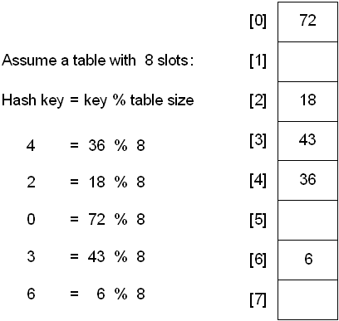
The Division Method

Slide 13
The Mid Square Method
Definition
  In this method, the key is squared and a portion from the middle is selected as the address for the key.
Steps:
  Suppose from a p-digit key, a q-digit address is to be obtained
  The p-digit key is firstly squared to yield a 2p-digit value
  The q-digit address if obtained from the 2p-digit value
Example
  Let p=4, q=3 and key=3271
  2p=3271*3271=10699441
  Thus the address can be either 699 or 994.
This method is quite flexible and be modified as desired

Slide 14
The Folding Method
Definition
  Suppose we have a p-digit key from which a q-digit address is to be obtained
  In this method the key is partitioned into groups of q-digits, starting from the right hand side
  The groups are then added and the right-most q-digits of the sum is selected as the address
Example
  Let p=8, q=3 and key=39427829
  Groups: 39/427/829
  Sum of the groups: 1295
  Address is: 295
This method is quite flexible and be modified as desired

Slide 15
Collisions
A hash function can generate same address for distinct key values. The key values which have the same address are often referred to as synonyms.
Methods to deal with synonyms/collisions are known as Collision Resolution Techniques
These techniques fall under two broad categories:
  Open addressing: In open addressing, no space outside the hash table is used for storing the key values.
  Chaining: In chaining, linked list are used for storing the key values
If a conflict occurs while inserting a key, one the conflict resolution techniques can be used

Slide 16
Linear Probe
In this open-addressing method, if the hashed address is already found to be occupied by an element then indices following the hashed index is sequentially examined to locate the first empty position. The position thus found is the new address of the key.
In Linear/Sequential probe, we consider the hash table to be circular.
For the function, we consider an array “a” of size m, another array “t” of the same size which stores whether an element of “a” is empty or not.

Slide 17
Linear Probe: Inserting a key
int insertLinear (int a[], int t[], int m, int k) {
int i=0,j;
j=hash(k);
do
{
if(t[j]==EMPTY)
{
a[j]=k;
t[j]=PRESENT; //EMPTY=0,PRESENT=1
return j;
}
i++;
j=(j+i)%m; //to ensure the index are within m.
}while(i<m);
return -1; //no space found where insertion can be made
}

Slide 18
Linear Probe: Searching a key
int searchLinear (int a[],int t[], int m, int k)
{
int i=0,j;
j=hash(k);
do
{
if(a[j]==k)
return j; //returns position where found
i++;
j=(j+i)%m; //to ensure the index are within m.
}while(i<m);
return -1; //not found
}

